Slide 1
Cables and Connectors
Course Code: CSC 3116
Course Title: Computer Networks
Dept. of Computer Science
Faculty of Science and Technology
Lecturer No: | Lab 4 | Week No: | 4 | Semester: | Summer 23-24
Lecturer: | Md. Faruk Abdullah Al Sohan; faruk.sohan@aiub.edu

Slide 2
Lecture Outline
Different types of devices
Ethernet Cabling
Terminal Emulation Software
Remote Access

Slide 3
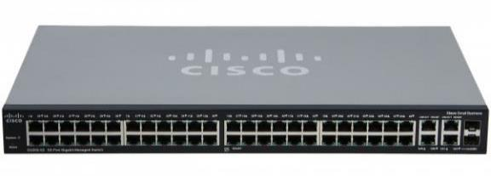
Cisco Switch
Fig. A 2960 series cisco switch

Slide 4
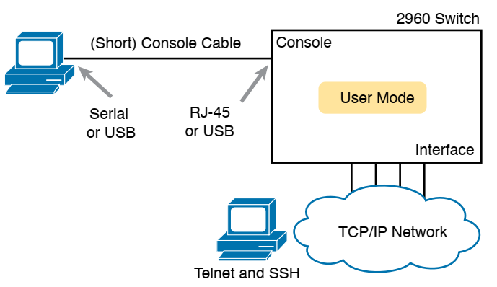
CLI access options
Fig. CLI access options

Slide 5
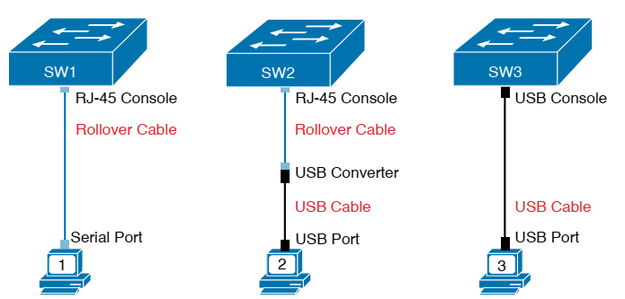
Console Connection to Switch
2960-XR series
supports both
the older RJ-45
console port
and a USB console port
USB console port is
Not rectangular
,rather it is
Mini-B port
Fig. Console Connection to a Switch

Slide 6
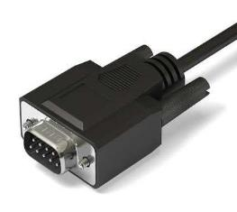
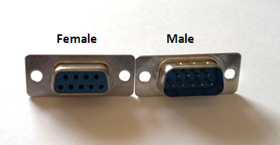
DB9 Connector
Almost obsolete
Replaced by USB
Fig. DB9 Connector (For serial port of PC)

Slide 7
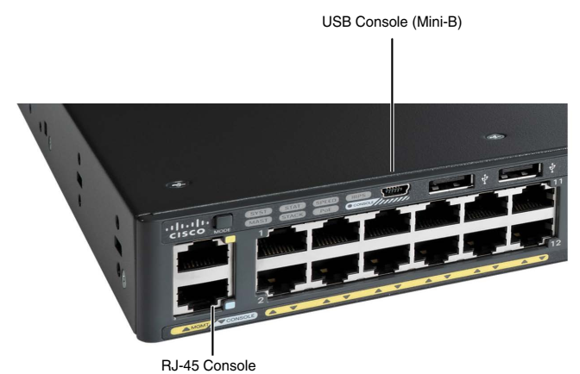
USB and RJ-45 Consle

Slide 8
Terminal Emulation Software
To interact with Switch/Routers
Examples
SecureCRT: Supports serial, Telnet and SSH → Not free
PuTTY: Supports serial, Telnet and SSH → free
TeraTerm Pro: Supports serial, Telnet and SSH → free
Windows Telnet (integrated to Windows OS) → Supports Telnet only
Windows HyperTerminal → Supports Telnet and Serial, NOT SSH

Slide 9
Remote Access
Telnet and SSH allows remote access to Switch/Router
Must need password to access the device
Telnet is not secure
No encryption
SSH is secure
Encryption is used

Slide 10
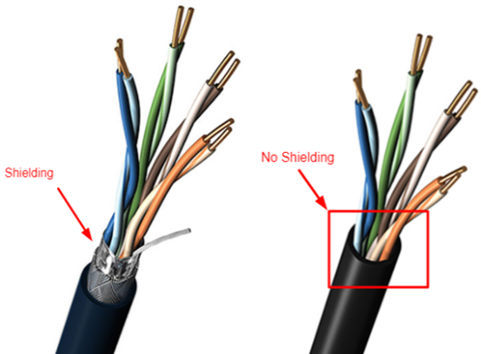
Ethernet cabling
Unshielded Twisted Pair (UTP)
Electromagnetic interference
Less data rate
cheap
Shielded Twisted Pair (STP)
Less interference
Higher data rate
costly

Slide 11
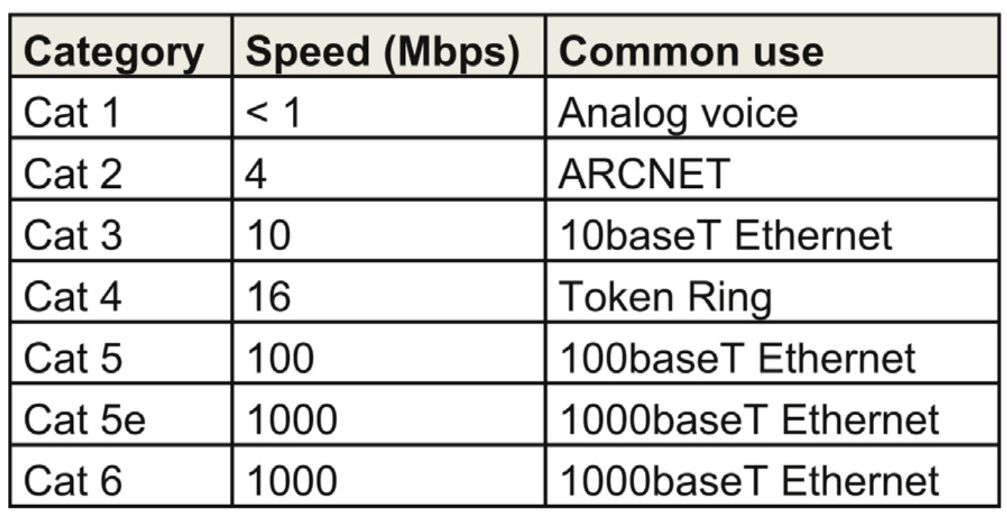
Ethernet cabling (contd…)
Table I Different categories of cable

Slide 12
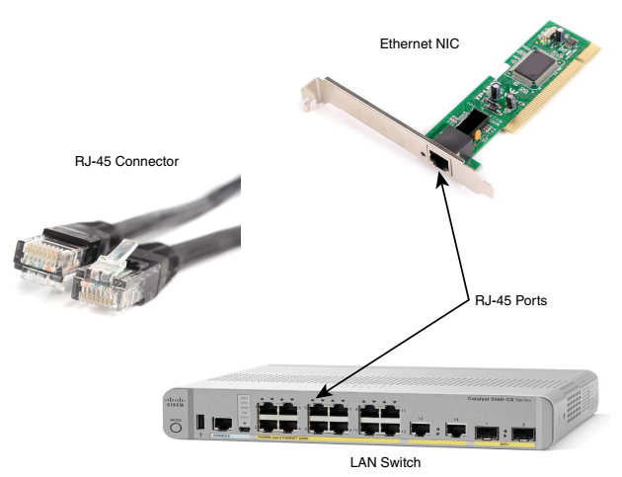
Ethernet cabling (contd…)

Slide 13

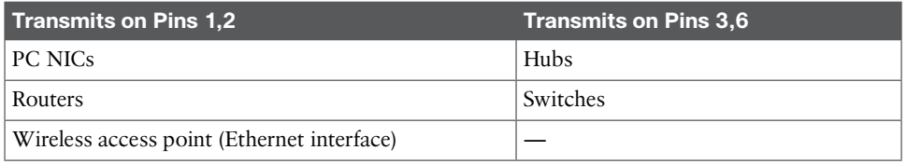
Ethernet cabling (contd…)
Straight-Through cable
PC to Switch or Hub
Router to Switch or Hub
Crossover cable
PC to PC
Switch to Switch
Hub to Hub
Switch to Hub
Router to Router
Router to PC
Rollover
PC to Console

Slide 14
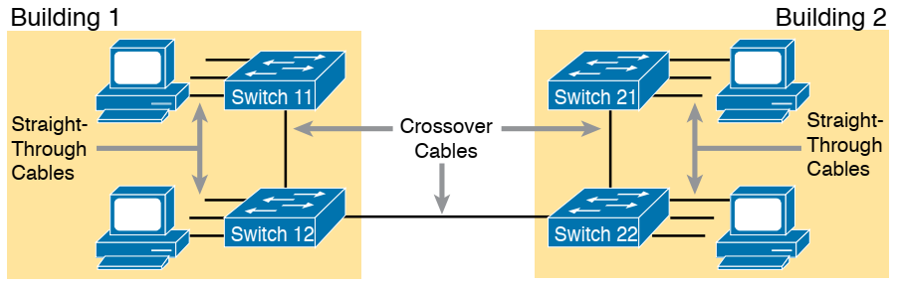
Ethernet cabling (contd…)

Slide 15
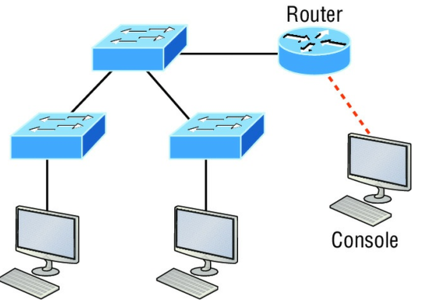
Ethernet cabling (contd…)
Identify cables

Slide 16
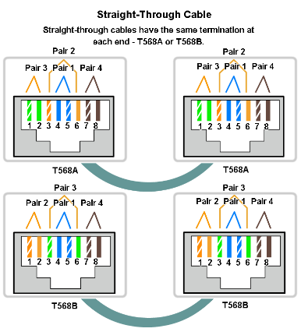
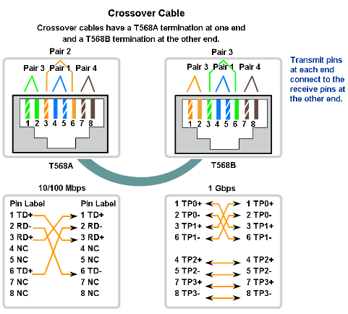
Ethernet cabling (contd…)

Slide 17
Suppose that we have three networks BBA, CSE, and EEE with IP requirements of 100, 350 and 80.
If You are given an IP block 10.10.0.0, allocate IPs performing subnetting.
Suppose that we have five networks A, B, C, D, and E with IP requirements of 10, 30, 90, 200, and 80.
If You are given an IP block 172.16.0.0, allocate IPs performing subnetting.
Consider your ID: AB-CDEFG-H, Suppose that we have four networks A, B, C, and D with IP requirements of 100*C, 10*D, 50*A, and 20*G.
If You are given an IP block 172.168.0.0, allocate IPs performing subnetting.

Slide 18
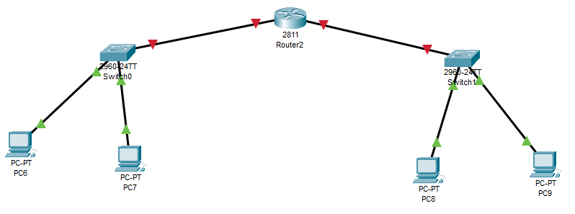
Suppose that we have two networks CSE and EEE with IP requirements of 10 and 8.
If You are given an IP block 192.168.0.0, allocate IPs performing subnetting.
192.168.0.14
255.255.255.240
192.168.0.22
255.255.255.248
192.168.0.1
255.255.255.240
192.168.0.14
192.168.0.2
255.255.255.240
192.168.0.14
192.168.0.18
255.255.255.248
192.168.0.22
192.168.0.17
255.255.255.248
192.168.0.22

Slide 19
Suppose that we have two networks CSE and EEE with IP requirements of 10 and 8.
If You are given an IP block 192.168.0.0, allocate IPs performing subnetting.
192.168.0.0/16
CSE→ 10 host → 4bit →192.168.0.0-15/28 → 255.255.255.240
Net address: 192.168.0.0/28
BC address: 192.168.0.15/28
Gateway: 192.168.0.14/28
EEE→ 8 host →3bit→192.168.0.16-23/29 → 255.255.255.248
Net address: 192.168.0.16/29
BC address: 192.168.0.23/29
Gateway: 192.168.0.22/29
RN-> 4 IP -> 2bit ->
192.168.0.24~27/30
255.255.255.252

Slide 20
References
1. Official Cert Guide CCNA 200-301 , vol. 1, W. Odom, Cisco Press, First Edition, 2019, USA.
2. CCNA Routing and Switching, T. Lammle, John Wily & Sons, Second Edition, 2016, USA.
3. Cisco IOS Configuration Fundamentals Command Reference.
http://www.cisco.com

Slide 21
Books
1. Official Cert Guide CCNA 200-301 , vol. 1, W. Odom, Cisco Press, First Edition, 2019, USA.
2. CCNA Routing and Switching, T. Lammle, John Wily & Sons, Second Edition, 2016, USA.

